Slide 1
Lessons From Failure
Don Dodge
Developer Advocate
Google
dondodge@google.com

Slide 2
Failure is not an option
It is a requirement
to learning

Slide 3
How do we learn?
Experience is making a mistake and learning from it
Failure is making the same mistake twice and not learning

Slide 4
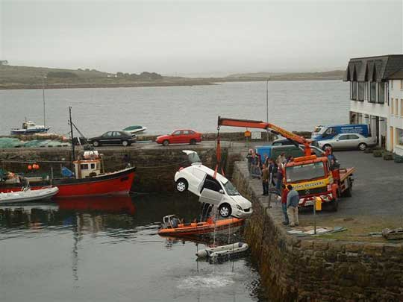
Mistakes happen

Slide 5
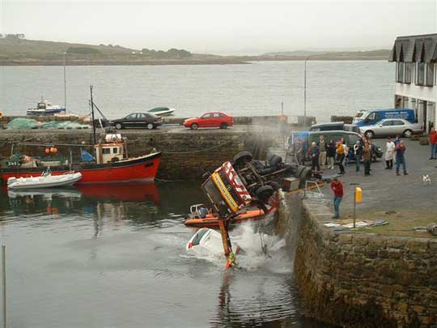
When we don’t plan

Slide 6
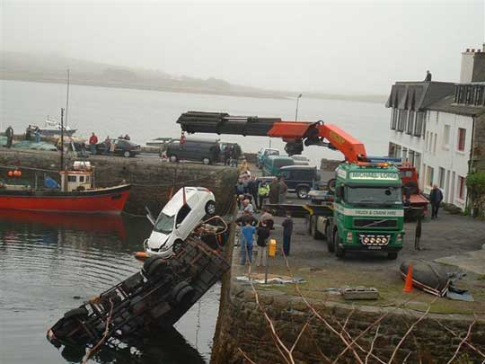
Big enough…

Slide 7
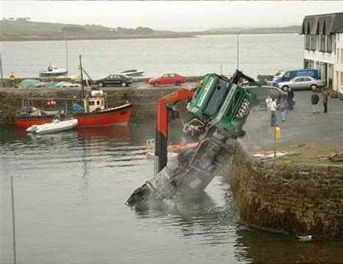
Plan really big!

Slide 8
Google plans big!
Achieving 60% of the impossible is better than 100% of the ordinary
If you are achieving 85% of your goals, you aren’t thinking big enough
If you haven’t failed, you aren’t trying hard enough

Slide 9
Failure = Experience
In Silicon Valley we don’t use the word “failure” we call it experience!
Failure is just experience on the way to success
Think big, start small, fail fast, succeed faster

Slide 10
Failure Is Not An Option
What do we mean when we say that?
  Try everything until you succeed?
  Don’t fail?
How do employees interpret it?
  If I fail once I’m fired
  If I spend over budget I’ve failed
Be sure you agree

Slide 11
Success is a terrible teacher
Success deludes us into thinking we know everything and can’t fail.
We learn more from failure than success
Success masks underlying problems
We overlook luck in success

Slide 12

Thomas Edison
I have not failed, I have just found many approaches that do not work.
I am not discouraged, because every wrong attempt discarded is another step forward.

Slide 13

Guitar Hero overnight success – 10 years

Slide 14

WD40

Slide 15

Angry Birds – 52nd game

Slide 16
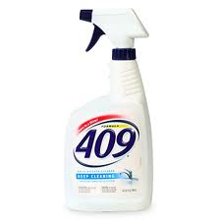
Formula 409 – keep trying

Slide 17
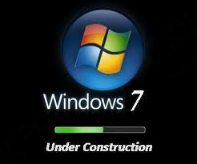
Windows 8? Keep trying

Slide 18
Attitude Adjustment
Fail Fast – Succeed Faster
Recognize mistakes as experience
Failure is making the same mistakes twice
Set impossible goals
Reward partial success

Slide 19
The Future?
Look back 10 years
Accelerate 2X

Slide 20
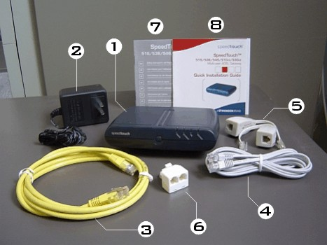
Internet 10 Years Ago
256K Modem
Cable Modems just emerging
Downloading software very slow
Music download slow
Video small postage stamp
Video playback slow and choppy
VoIP not reliable

Slide 21
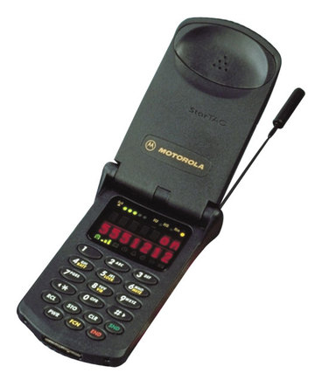
Cell Phone 10 Years Ago
Motorola StarTac
None of;
Text messaging
Email
Camera
Web browser
Search
Applications
GPS locations
Maps
Voice recognition

Slide 22
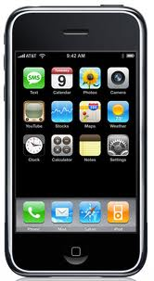
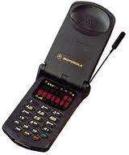
In 3 Years

Slide 23
Future of Computing
Cell phone is your computer
Wireless bandwidth explosion
Everything in the Cloud
Voice recognition – command and response
No need for office – work anywhere
Video conferencing on your phone
Everything faster, smaller, cheaper

Slide 24
Thank You
Don Dodge
Google
dondodge@google.com

