Slide 1

Netrepreneurs, the New Breed of Entrepreneurs
Marius Ghenea
Poznan, Oct 10

Slide 2
The Entrepreneurial Motto
“Search and luck
lead to opportunity”

Slide 3
The Entrepreneurial Definitions
An entrepreneur is an intermediary between capital and labor (original French definition by Richard Catillon)
An entrepreneur is someone who organizes a business venture and assumes the risk for it
An entrepreneur is a person who has possession of a new enterprise, venture or idea, and assumes significant accountability for the inherent risks
An entrepreneur is a person who is willing and able to convert a new idea or invention into a successful business
An entrepreneur is any person who looks at a problem and sees it as an opportunity, and then acts on it!
In fact, the entrepreneurship goes way beyond simple definitions...

Slide 4
Types of Entrepreneurship
Social Entrepreneurship
Political Entrepreneurship
Knowledge Entrepreneurship
Intrapreneurship
Cultural Entrepreneurship
Netrepreneurship
Etc.

Slide 5
The Intrapreneur
in·tra·pre·neur ˌɪn trə prəˈnɜr, -ˈnʊər, -ˈnyʊər
–noun
an employee of a large corporation who is given freedom and financial support to create new products, services, systems, etc., and does not have to follow the corporation's usual routines or protocols.

Slide 6
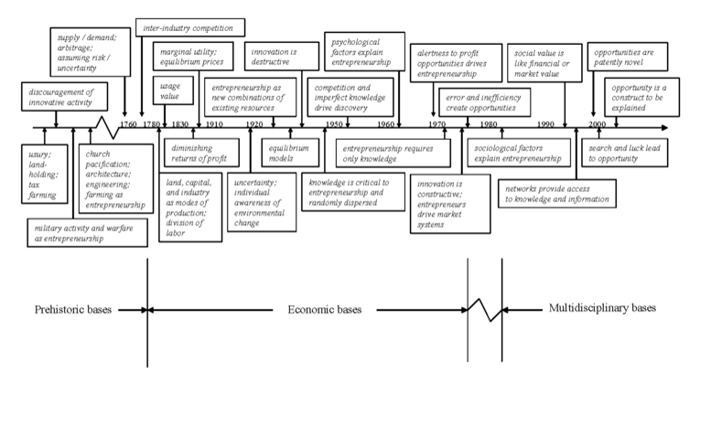
A historical perspective
Short history of entrepreneurship
  - until ca. 1760: “pre-historical” bases
  - ca. 1800 – 1970: economical bases
  - 1970 – 2000 and beyond – social implications, “reinventing” entrepreneurship

Slide 7

Entrepreneurial functions
The “4A+1” List
Aggregation
Arbitrage
Advancement
Ambiguity
A is All Action!

Slide 8
Entrepreneurs: born, or made?
Entrepreneurs are made!
Most of the attributes can be taught and must be learned
Even the more innate skills can be improved in practice
Entrepreneurs develop and perfect in time (the 10K hour rule applies)

Slide 9
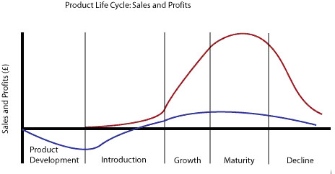
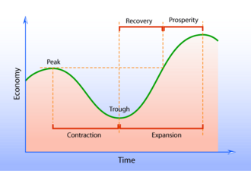
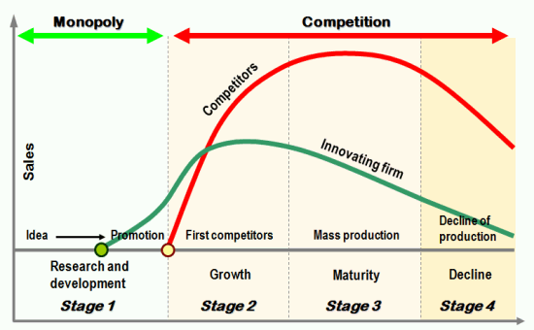
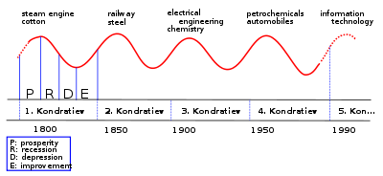
Waves, cycles, entrepreneurs

Slide 10
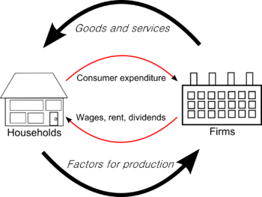
Schumpeter and his contribution
“an entrepreneur is a person who is willing and able to convert a new idea or invention into a successful innovation”
The economic development theory: “business-cycles” and the “circular flow”
Without innovation, the circular flow remains static
The Entrepreneur is the one taking the economic cycle into a dynamic mode, towards the next cycle

Slide 11
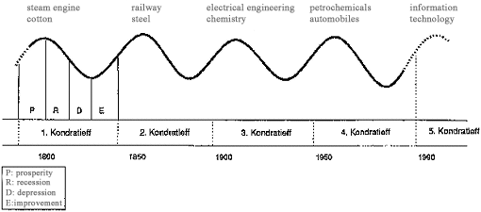
Kondratieff cycles & entrepreneurs
Industrial Revolution - 1770
The Age of Railways - 1820
The Age of Steel and Electricity - 1870
The Age of the Automobile - 1920
The Age of IT - 1970
The next Age: the post-information age? The Google Age? Or the Facebook Age? 2020?

Slide 12


Slide 13
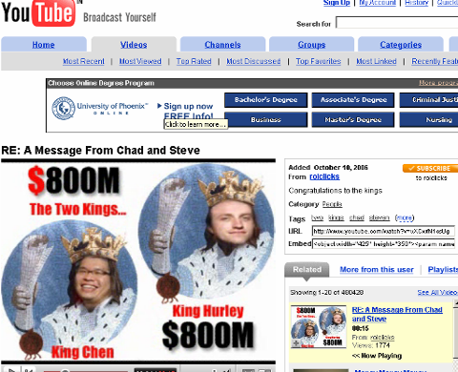
The Netrepreneurs
Famous netrepreneurs:
Jerry Yang & David Filo (Yahoo)
Serghei Brin & Larry Page (Google)
Steve Chen si Chad Hurley (YouTube)
do they all come in pairs?

Slide 14

The Netrepreneurs

Slide 15
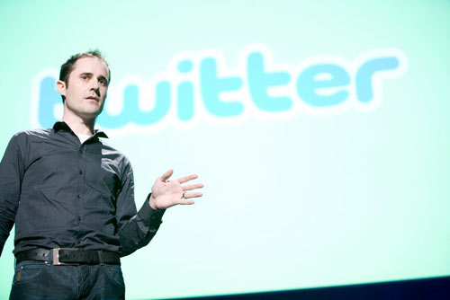

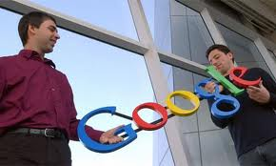
The Netrepreneurs
Usually young, informal,
iconoclast

Slide 16

The Netrepreneurs
they bet on rapid growth after start-up, followed by quick exit, be it through IPO (e.g. Google), be it as an exit to a strategic buyer (e.g. YouTube)
young (but no necessarily teenagers or even in their twenties) informal, anti-system, changing business paradigms (rather, ignoring them)
let’s say that again: they always come in pairs or in teams!

Slide 17
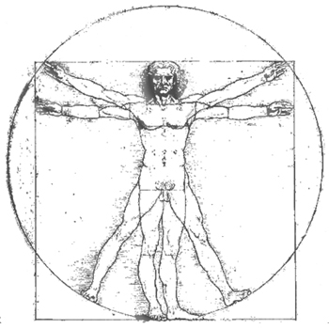
The Role of the Team

Slide 18
The Role of the Netrepreneurial Team
The Visionary
The Sales Guy
The Finance Expert
The Marketing Guru
The Operations Specialist
The Tech Geek
The People’s Person

Slide 19
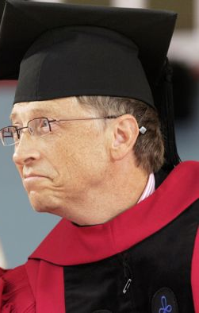
Entrepreneurs and degrees
“Drop-out billionaire” myth busted!

Slide 20


From Entrepreneurship to Corporations

Slide 21
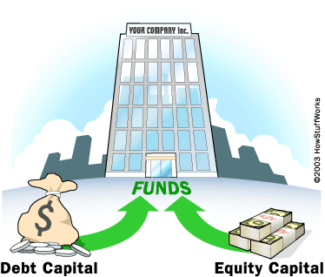
Sources of Capital

Slide 22
Types of Funds and Capital
Capital: Equity and Debt
Types of Funds: Internal and External
External Funds: Personal, 3F, Vendor Funds, Bank Loans, BA, VC, PE, LP’s, IPO’s, European/Govt Funds
Internal Funds: profits, sales of assets, W/C reduction, extended A/P, reduced A/R, bootstrapping, etc.

Slide 23

Financing growth

Slide 24
Financing an entrepreneurial start-up
Personal resources, including small personal loans from banks
“The 3F”: Family, Friends, and other Fools
Bootstrapping: developing the business without additional external financing
Vendor Credit: the cheapest credit one could get, but it requires TRUST, plus some formal credit checks, sometimes
Business-Angels, probably the most interesting financing option for an entrepreneurial start-up
Venture Capital or Private Equity (rarely invest in early-stage/start-ups)
The Bank remains the cheapest source for the financing of an entrepreneurship, but almost never gives credit to start-ups!
IPO’s: ideal COMBO for sources of funding and exit route, rarely seen in start-ups, at least after the 2000 dot-com bubble burst!
EU/Govt grants/funds are a new interesting resource, particularly for new-Europe countries (EU accession countries from 2004 and 2007), but projects need to be carefully analyzed to see if this solution really pays-off!

Slide 25
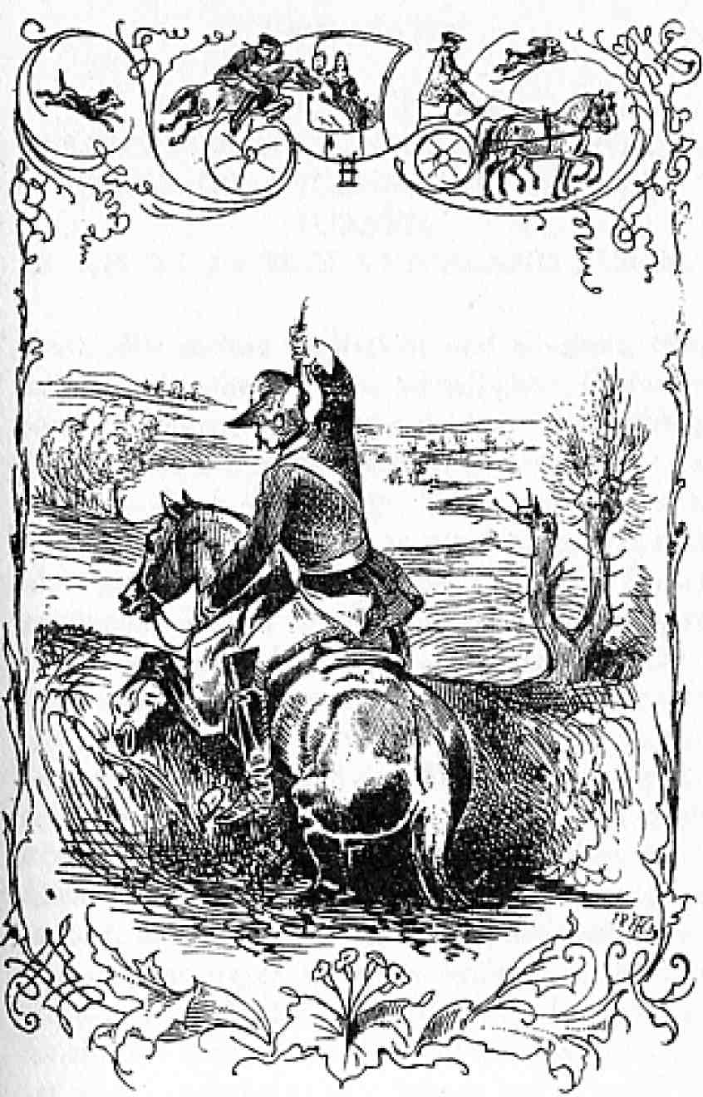
Bootstrapping

Slide 26

Bootstrapping, the 10 commandments
1. Start from home!

Slide 27
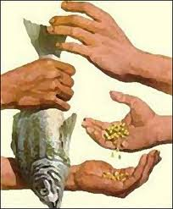
Bootstrapping, the 10 commandments
2. Barter!

Slide 28

Bootstrapping, the 10 commandments
3. Function over form!

Slide 29

Bootstrapping, the 10 commandments
4. Use volunteers, interns!

Slide 30

Bootstrapping, the 10 commandments
5. Do use the Internet!

Slide 31
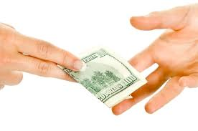
Bootstrapping, the 10 commandments
6. Cash advances!

Slide 32

Bootstrapping, the 10 commandments
7. WOM (word-of-mouth)

Slide 33

Bootstrapping, the 10 commandments
8. Start from the bottom...

Slide 34

Bootstrapping, the 10 commandments
9. Fast to the market!

Slide 35

Bootstrapping, the 10 commandments

Slide 36
Bootstrapping, summary
Start from home!
Barter!
Function over form!
Use volunteers and interns
Do use the Internet!
Cash advances!
WOM
Start from the bottom...
Fast to the market!
Cash-flow over profit!

Slide 37

Business-angel financing for start-ups
How would a BA analyze a start-up pitch? What would matter most, for him?
Similarly, what would matter for an antrepreneur?
the expertise
the specific achievements
the reputation
the commitment
the passion
the chemistry

Slide 38
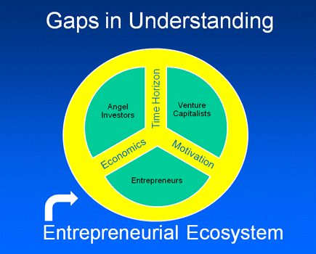
Diferences in perspective

Slide 39
Growth by Entrepreneurial type
There is no “right” or “wrong” way about growing one’s business, it all depends on the entrepreneur(s) and his/her/their vision
Growth, however, is in the human nature, so it is also deeply rooted in any business venture

Slide 40
Accessing External Resources for Growth
Franchising
Joint Ventures
Acquisitions
Mergers
Leveraged buyouts

Slide 41








Social activities for entrepreneurial development in the region

Slide 42

The new book on entrepreneurship

Slide 43
Thank You!
Q&A

