Slide 1

e-commerce trends
CEO Allegro Group – Grzegorz Wójcik

Slide 2
Topics for E-nnovation
1
E-commerce – business models
2
2011 Trends in e-commerce
3
CEE inspirational facts

Slide 3
Topics for E-nnovation
1
E-commerce – business models
2
2011 Trends in e-commerce
3
CEE inspirational facts

Slide 4


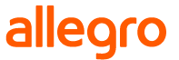















Business Models
Classfields
Marketplaces
Online Retail
C2C
b2C
B2C

Slide 5
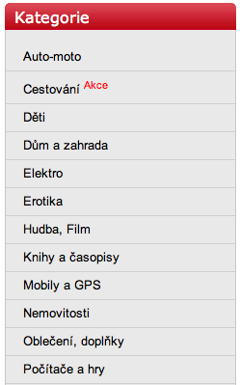
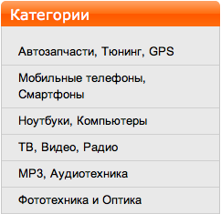
What’s on sale?
Variety of Goods
Virtual goods & services
Digital content

Slide 6
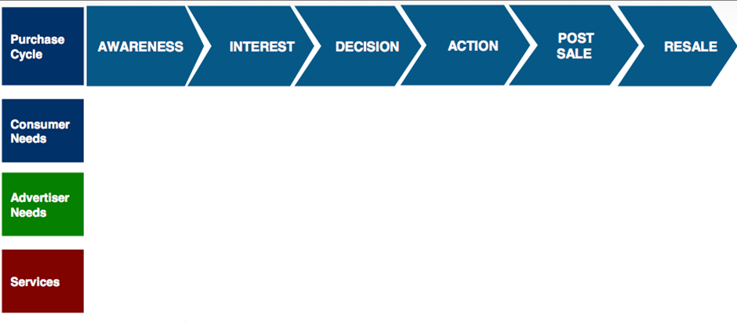
Follow the Consumer
E-
E-COMMERCE
VALUE CHAIN

Slide 7
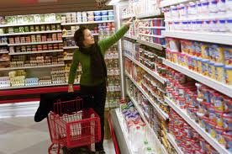
How to act in E-commerce
Customers’ decision-making process
Selection & availability
Price
Trust / safety
Transaction
Fulfilment / delivery
Payment
Customer Support Quality

Slide 8
Topics for E-nnovation
1
E-commerce – business models
2
2011 trends in e-commerce
3
CEE inspirational facts

Slide 9

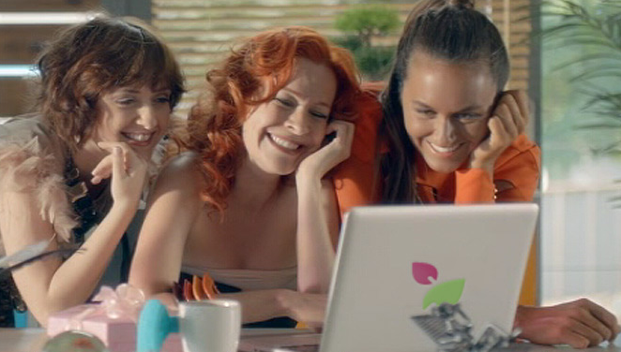
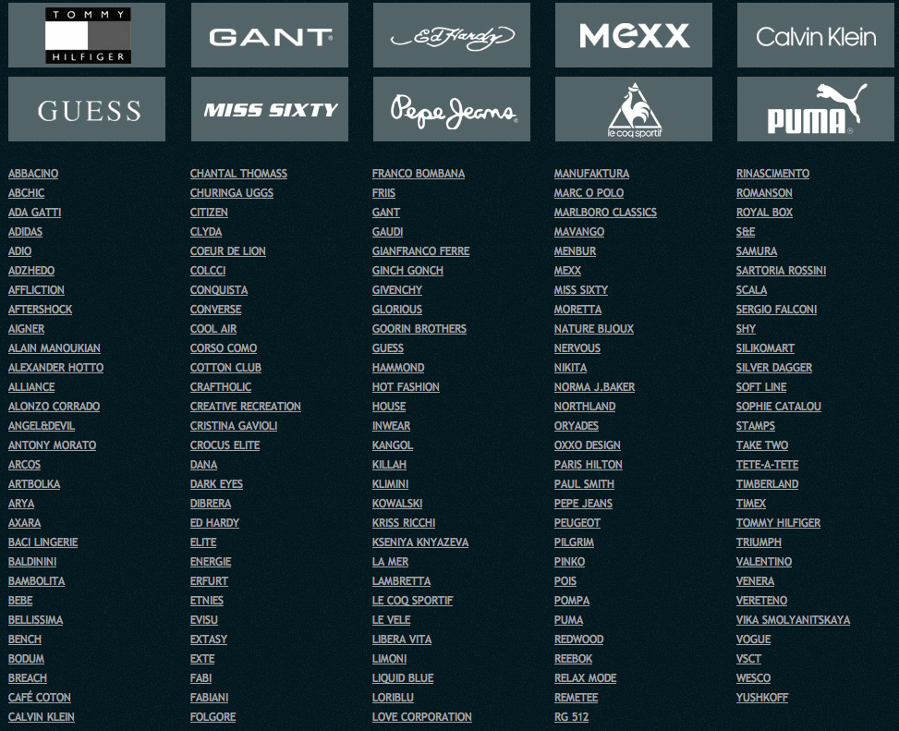
BRANDS ONLINE
1

Slide 10
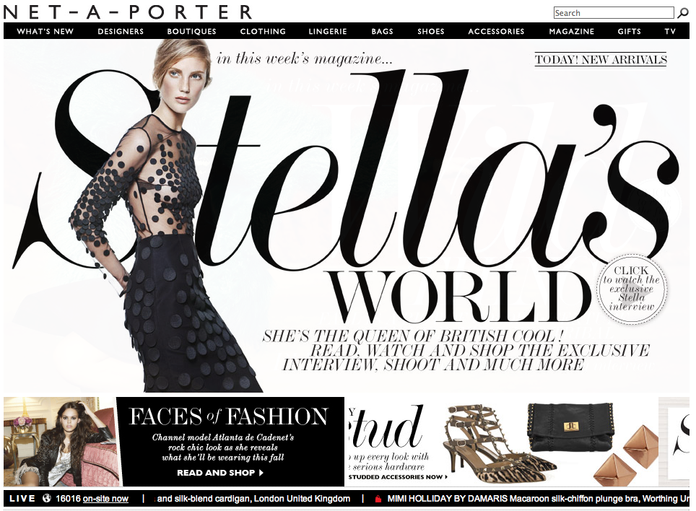
Learn from designers
Notes:
Broadband changes everything. Video is allowed online. Advertising vs. Product information? Interactive forms.
Broadband zmienia wszystko. Wideo jest akceptowane w sieci! Reklama a informacja produktowa? Formy interaktywne.

Slide 11
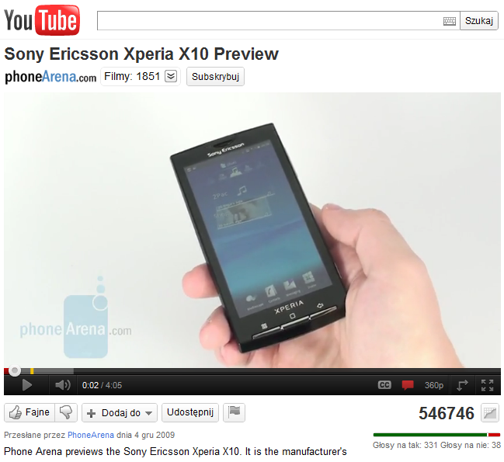
Online presence
Facts
Own website
is not enough
Your product catalogue must be with rich content
Value your customers’ recommendation
Notes:
Broadband changes everything. Video is allowed online. Advertising vs. Product information? Interactive forms.
Broadband zmienia wszystko. Wideo jest akceptowane w sieci! Reklama a informacja produktowa? Formy interaktywne.

Slide 12

Introduce your brand
Facts
Online presence brings value to your brand
Discount deals are just offline routine
Look for commerce targeted traffic
Notes:
Broadband changes everything. Video is allowed online. Advertising vs. Product information? Interactive forms.
Broadband zmienia wszystko. Wideo jest akceptowane w sieci! Reklama a informacja produktowa? Formy interaktywne.

Slide 13



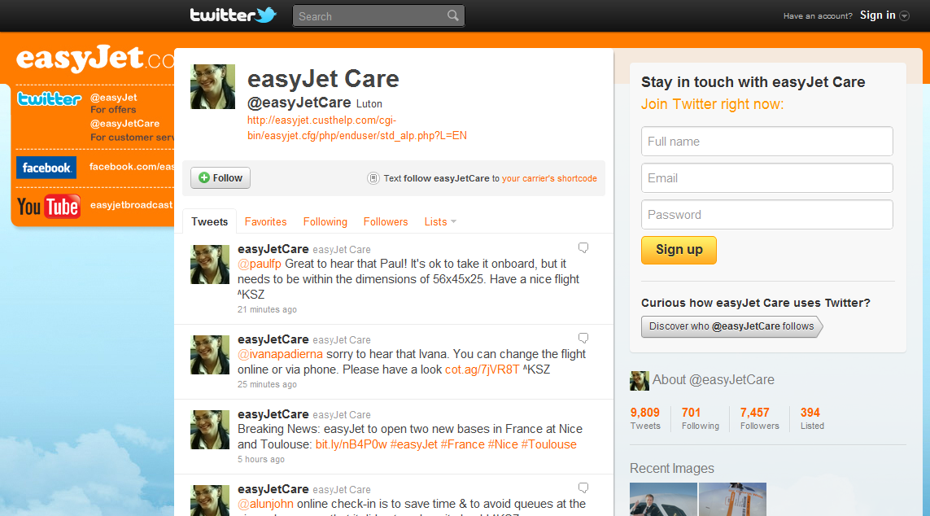
“Social” customer care
Notes:
Social media has become additional customer service channels. Rule for every business: dissatisfied customer + internet = imediate retreat of thousands of customers.
Kanały społecznościowe (facebook, twitter) stały się dodatkowymi punktami obsługi klienta. Reguła dla każdego biznesu: niezadowolony klient + internet = natychmiastowy odwrót tysięcy klientów!!!

Slide 14












Lead generation
Notes:
What is Groupon now? What it will be in 12 months’ perspective?
Number of services based on the same business model!
Czym jest Groupon? Czym będzie?
Liczba klonów Groupona na świecie!

Slide 15

Delivering e-transactions
Be smart
Great website usability brings convertions
Distribute your products with partners (high traffic consumer destination sites)
Transaction is just the beginning – now you need to deliver it ☺
Notes:
What is Groupon now? What it will be in 12 months’ perspective?
Number of services based on the same business model!
Czym jest Groupon? Czym będzie?
Liczba klonów Groupona na świecie!

Slide 16
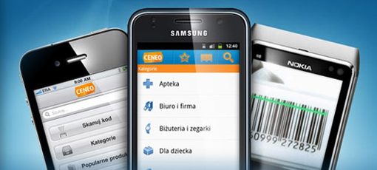
MOBILE EXPERIENCE
2
Notes:
In 2010 for the first time in history sales of smartphones exceeded sales of personal computers.
http://www.youtube.com/watch?v=kwdnSt8tHEg
Nectar app is an example of how personalised offer will look like in the near future. Available on IOS, Android and Nokia phones allows access to exclusive bonus points offers only available on the App, shop through the App and collect points with over 60 online retailers, check Nectar points balance on the go, and is also a handy store locator to find out where to collect and spend points near you.
Personalisation squared – mobile phones accompany customers everywhere. How long the switch to smartphones in CEE is going to take?
Personalizacja do². Telefony komórkowe są z nami zawsze i wszędzie. Jak długo potrwa wymiana telefonów na smartfony w CEE?

Slide 17
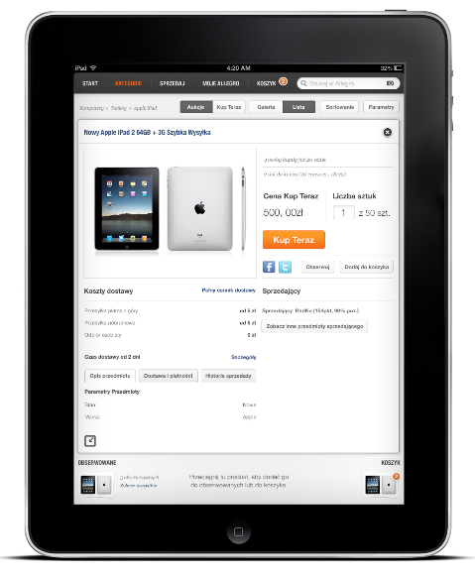
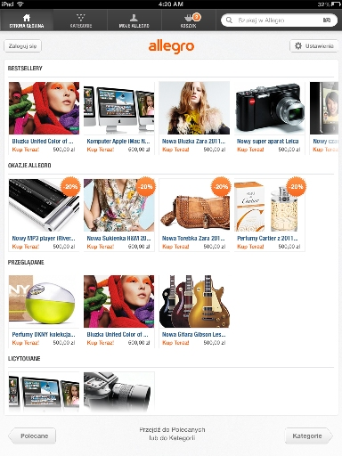
Speed of transformation
Source: Gfk Polonia
Notes:
In 2010 for the first time in history sales of smartphones exceeded sales of personal computers.
http://www.youtube.com/watch?v=kwdnSt8tHEg
Nectar app is an example of how personalised offer will look like in the near future. Available on IOS, Android and Nokia phones allows access to exclusive bonus points offers only available on the App, shop through the App and collect points with over 60 online retailers, check Nectar points balance on the go, and is also a handy store locator to find out where to collect and spend points near you.
Personalisation squared – mobile phones accompany customers everywhere. How long the switch to smartphones in CEE is going to take?
Personalizacja do². Telefony komórkowe są z nami zawsze i wszędzie. Jak długo potrwa wymiana telefonów na smartfony w CEE?

Slide 18
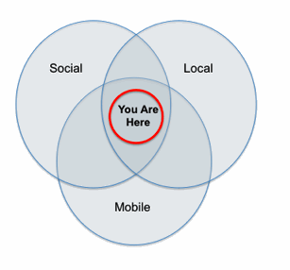
What is mobile commerce?
Notes:
Earned media – the new, significant channel for retailers.
Traffic generated by social media to trading platforms increases dynamically.
It’s becoming significant for the sellers.
But characteristics of this traffic is utterly different.
Ilość ruchu (traffic) z serwisów społecznościowych do platform zakupowych dynamicznie rośnie.
Ruch zaczyna być istotny dla sprzedawców.
Charakterystyka tego ruchu jest jednak zupełnie inna.

Slide 19
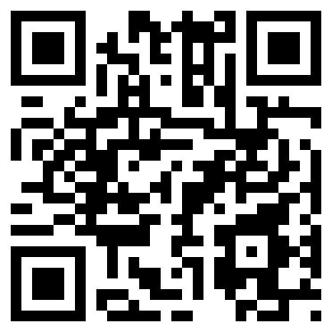
Online & Offline
Source: The Mobile Movement Study, Google/Ipsos OTX MediaCT
Notes:
TUTAJ GRZEGORZ MA ZADEMONSTROWAĆ SKANOWANIE KODU KRESKOWEGO Z PUDEŁKA LEGO
E-offline – offers from local retailers combined with mobile phones improve competetiveness.
E-offline LOKALNE OFERTY i telefony zwiększają konkurencyjność handlu.

Slide 20

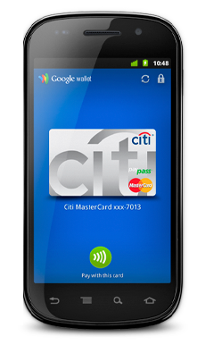





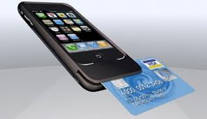
Payments… and trust
3
Notes:
NFC technology
Every transaction has to be finalised with fast and secure payment.
Każdą transakcję trzeba sfinalizować szybką i bezpieczną płatnością.

Slide 21
Topics for E-nnovation
1
E-commerce – business models
2
2011 Trends in e-commerce
3
CEE inspirational facts

Slide 22
Online habits

Slide 23

B2C transformation in CEE
In 2010:
87% of all items are offered in
Fix price [Buy Now!]
7 500 000 000 PLN
Value of items sold
281 000 000
Deals offered annually
13 535 033
Registered users
Source: Allegro Group

Slide 24



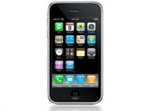
Cools facts from Allegro
In 2010:
215 115 Laptops
200 305 Software
68 452 Tv screens
24 798 Iphones
were sold.
Source: Allegro Group

Slide 25



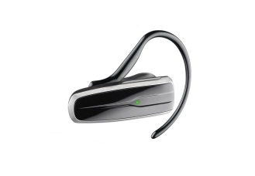

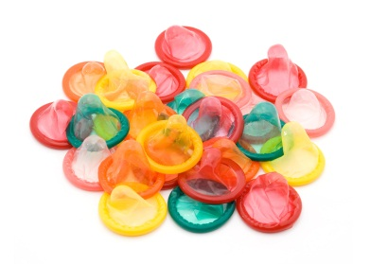
Cool facts from Allegro
Every…
3s a household accessory
4s a beauty product
3s a wedding invitation
4s a GSM accessory
4s a car part
28s a condom
…is sold.

Slide 26
Fashion is trendy…
Top categories

Slide 27












Offline → Online

Slide 28
