Slide 1
Mobility
Technology Overtakes Users’ Needs
Kamil Brzeziński
Head of Mobile Allegro Group

Slide 2

Who is this guy?
Current
Head of Mobile in Allegro Group
Past:
IT background from developer, tester, comapany owner, manager
Publisher and jurnalist
Salesman

Slide 3
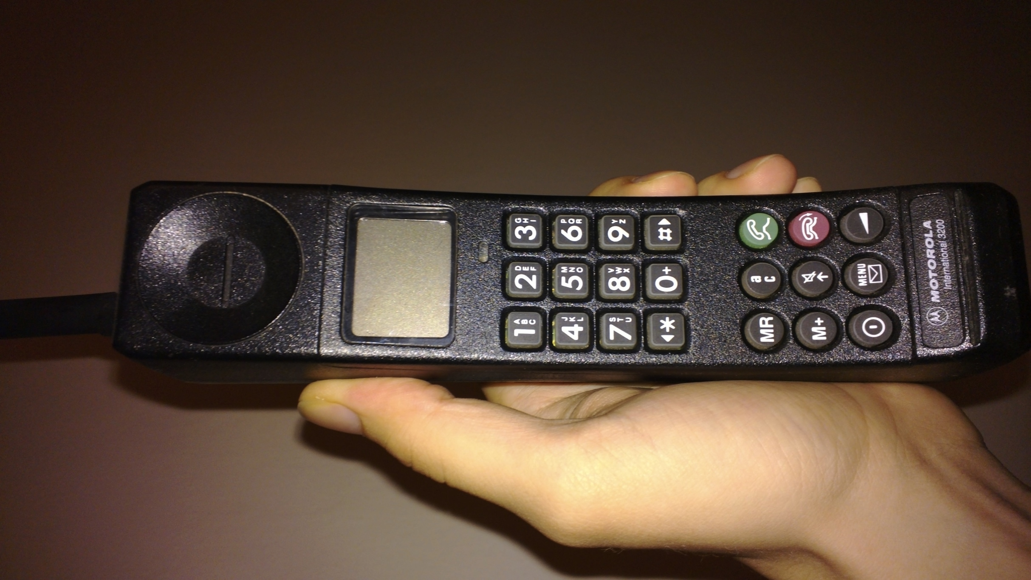
Mobile history
Just phone calls

Slide 4
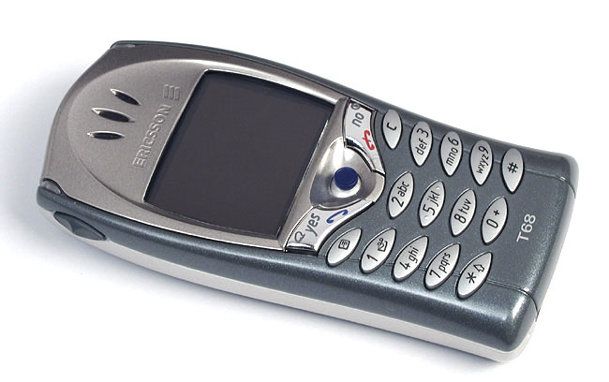
Some time ago
Phone calls, SMS, MMS, Camera, WAP

Slide 5
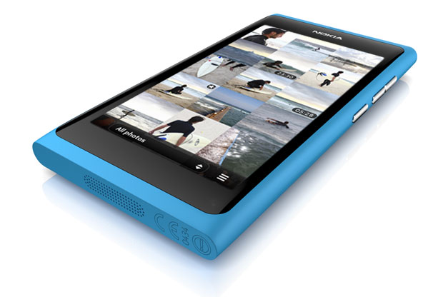
Current mobile phones
Global roaming
Multitouch display
Internet faster than at home
8Mpix camera
Bluetooth
GPS
NFC
Video out
USB
WiFi
E-mail
WWW
Facebook
Twitter
Skype

Slide 6
Mobile phone sales
OS/share | 2009 | 2010 | 2011 | 2015
Android | 3.9% | 22.7% | 38.5% | 48.8%
BlackBerry | 19.9% | 16.0% | 13.4% | 11.1%
iOS | 14.4% | 15.7% | 19.4% | 17.2%
Symbian | 46.9% | 37.6% | 19.2% | 0.1%
Windows Phone/Mobile | 8.7% | 4.2% | 5.6% | 19.5%
Others | 6.1% | 3.8% | 3.9% | 3.3%
Total smartphones | 172 million | 297 million | 468 million | 631 million
Source: Gartner (04.2011)

Slide 7
400 000 apps
videocalling
7” screen tablet phone
Dual core
768MB RAM
Retina
Bluetooth
16GB flash
3D glasses-less display
NOVA display
Super AMOLED Plus
5” screen phone
NFC
Touch screen
Quad Core
12Mpix camera
1.5GHz
DLNA

Slide 8
Users just don’t understand

Slide 9
DO NOT promote features!
SHOW how can it be used

Slide 10
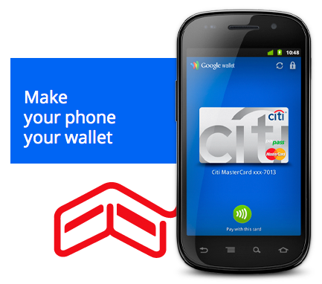
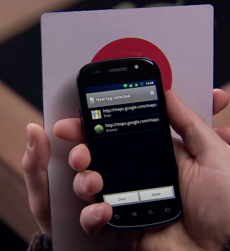
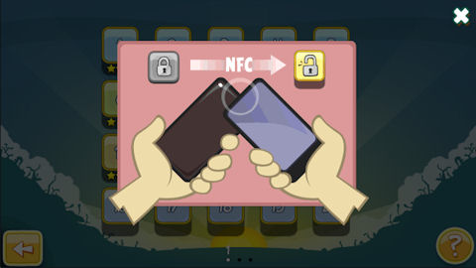
NFC

Slide 11
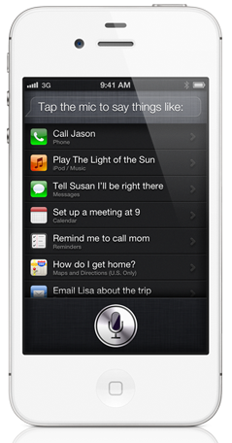
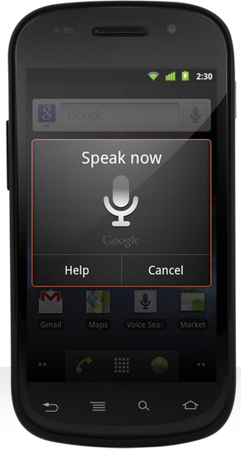
Voice control
Siri in iPhone 4S
Voice Actions

Slide 12

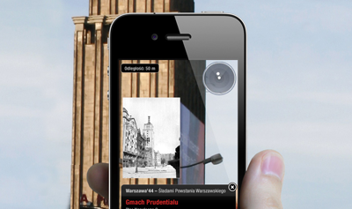

Location based services
Billion check-ins on

Slide 13
Payments

Slide 14
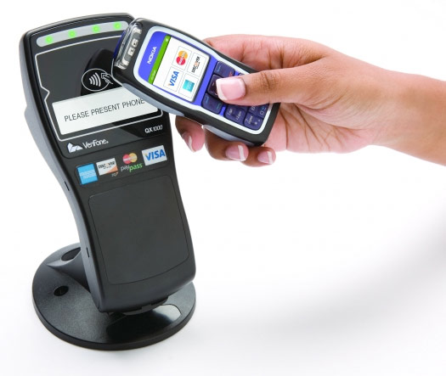
Mobile payments
applications
NFC
SkyCash
VISA
MasterCard
UUSD codes
Google Wallet
mPay

Slide 15
Mobile transactions
13,5mln customers in Western Europe
Mobile transactions growth Q1 vs Q2 2011
Source: ComScore 2011

Slide 16
Allegro Group
m-commerce

Slide 17
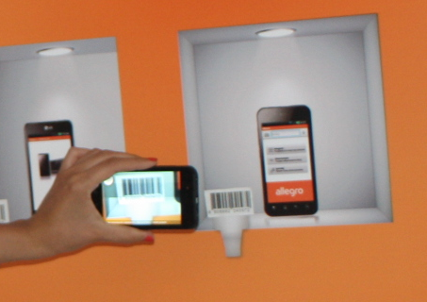

Mobile price comparision
2mln text searches/week
4500 barcode scans/week
2 000 images/week

Slide 18
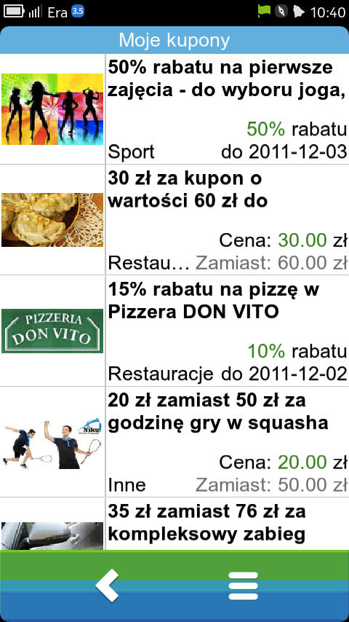
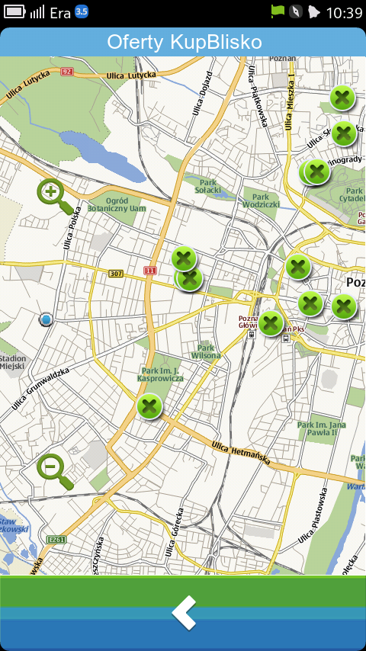
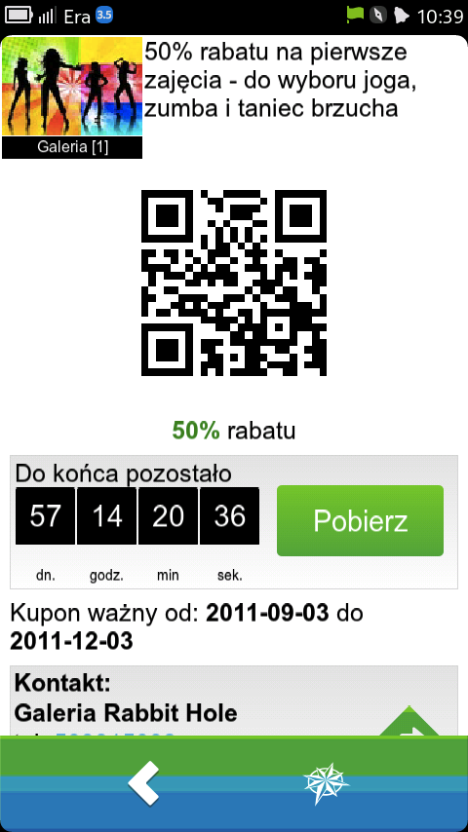
Mobile vouchers

Slide 19
Mobile shopping
Mobile transactions per platform
Over 2.5 mln monthly visits via mobile Allegro
Over 40% conversion in mobile Ceneo

Slide 20
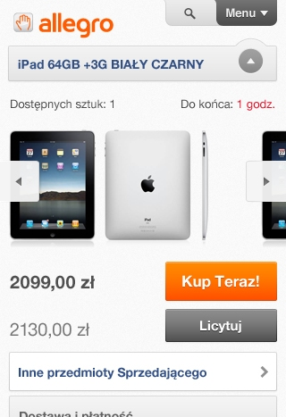
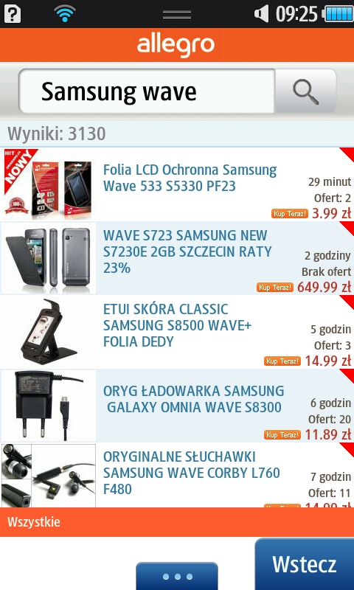
Mobile sites are still more popular than applications
>

Slide 21
Don’t ask user what they need.
Give them what thay should need.

Slide 22
Thank you

