Slide 1

How to enhance customer engagement?

Slide 2


Slide 3
Agenda
From commerce to e-commerce
Market trends
What is driving e-commerce?
The touch points
How can the payment service provider help your business?

Slide 4



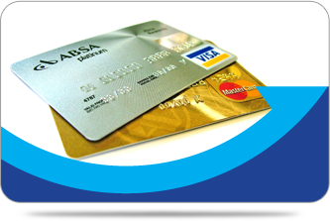

A history of commerce

Slide 5





A history of commerce

Slide 6
e-commerce

Slide 7
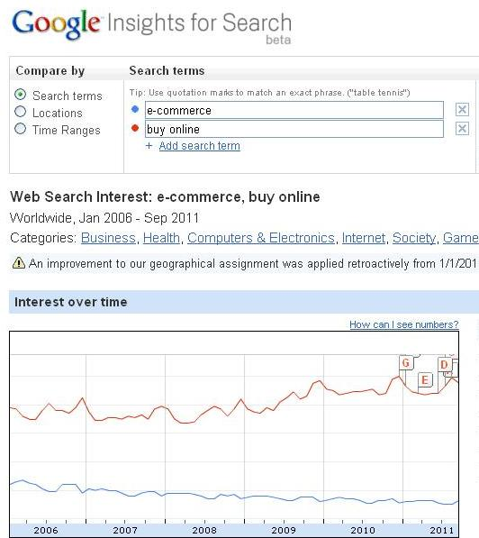
Market trends

Slide 8
Is e-commerce dying?

Slide 9
What is driving e-commerce?

Slide 10

The customer!

Slide 11
Listen and focus on your customer!
More business?

Slide 12
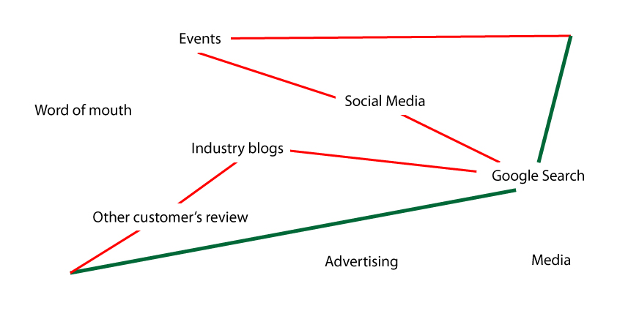


Touch points
Set expectations
Create interest
Generate sales

Slide 13
Touch points
  We will define a touch point as any customer interaction or encounter that can influence the customer's perception of your product, service, or brand.
  Touch points can occur long before a customer actually makes a purchase and long after they have made their first transaction.
  The goal of every company interested in leveraging customer experience as a competitive advantage is to create a positive and consistent experience at all of the touch points.
  Source: http://www.customerthink.com/

Slide 14


How can the payment service provider help
  User’s experience
  Customer engagement
  Business’ growth

Slide 15
How can the payment service provider help
  Multiple payment options
  Customer's’ support (24/7/365)
  Localization (language, currency)
  Security (PCI DSS level 1, McAfee daily scans)

Slide 16
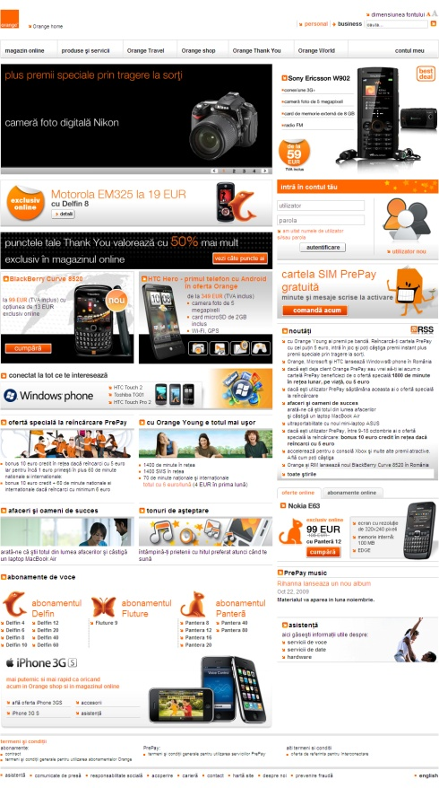
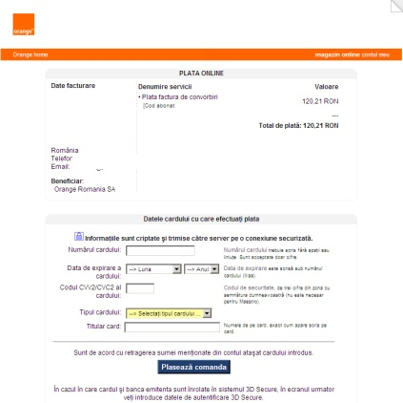





How we address the touch points
Hotline: +40 21 303 20 60 (24/7/365)
support@epayment.ro

Slide 17
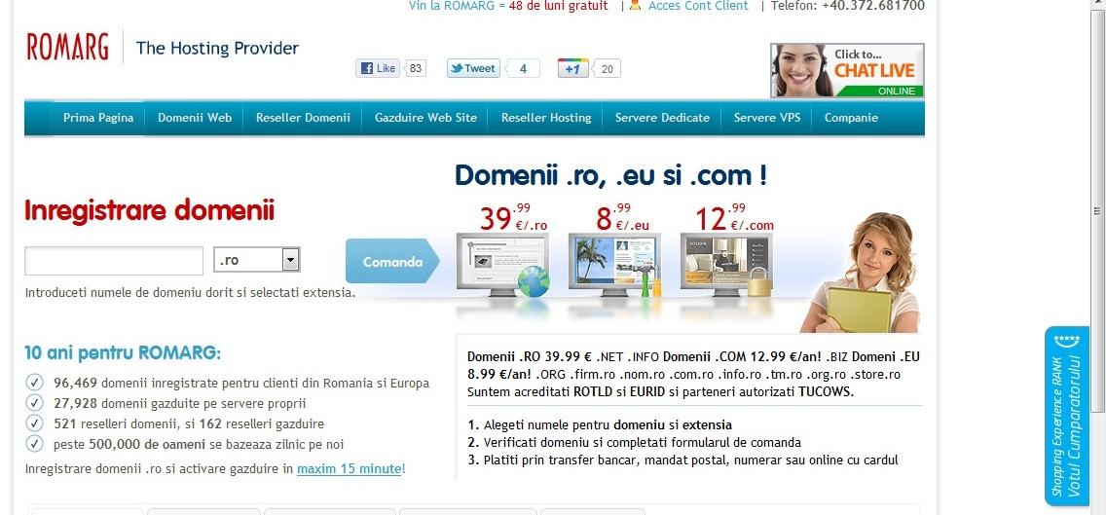
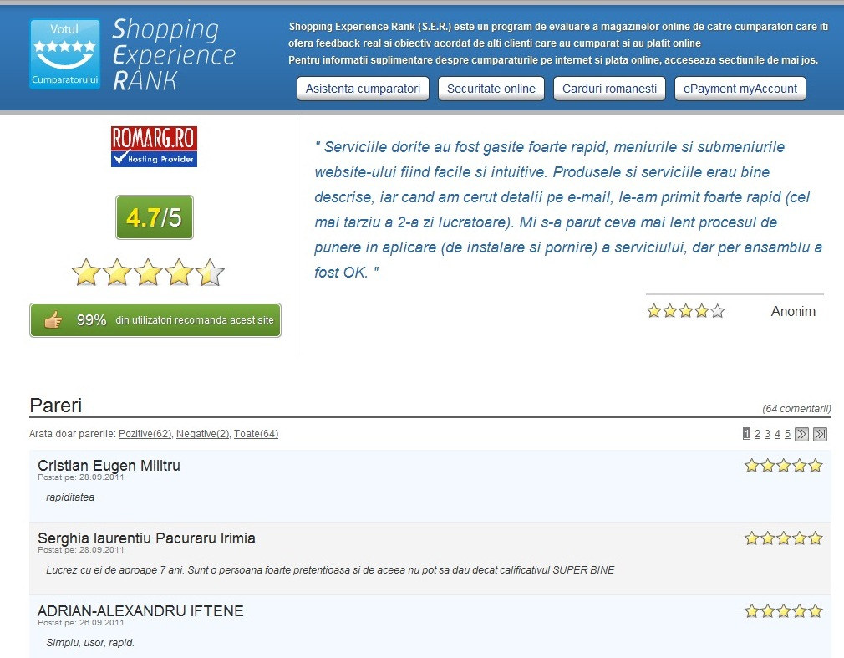
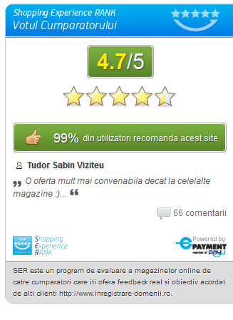
How we address the touch points

Slide 18



Conclusions
Touch points – objectives
Enhance customer’s
  experience
Drive engagement
Be memorable

Slide 19

Conclusions
  We are in touch with our customers by multiple touch points
  Let’s professionally assume our role and optimize the touch points!

Slide 20
About ePayment
  ePayment in a nut-shell
  ecommerce integrator helping online shops to manage multiple payment options within a secured environment
  History
  Member of Naspers Group, (2010)
  Launched in 2004, by GECAD Group
  Clients
  Merchants in Romania: 2,000+
  Experience in managing key players, leaders in their area of activity – large volumes, customized implementation

Slide 21













































Clients who trust our services

Slide 22
Thank you!
Phone: +40 (0) 21 303 2066
Email: info@epayment.ro
Website: www.epayment.ro
Blog: http://blog.epayment.ro/
Twitter: http://twitter.com/ePayment

